Slide 1


Node jS
Tal Yaron

Slide 2
What is Node js?
Node.js® is a JavaScript runtime built on Chrome's V8 JavaScript engine.

Slide 3

Ryan Dahl
Node.js creator
Created a new runtime called Deno

Slide 4
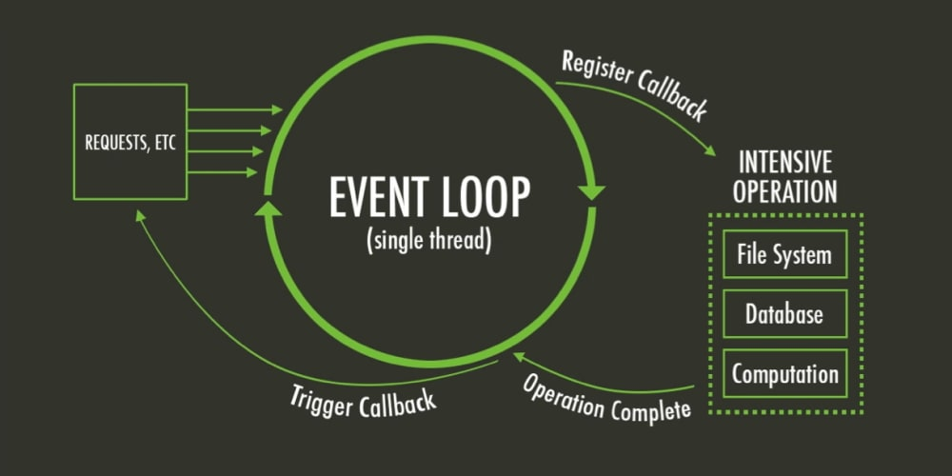
The event loop
Non blocking singl thread

Slide 5

The event loop
Non blocking singl thread

Slide 6
The event loop
Non blocking singl thread
Good for: io, working with database
Not suited for: Video processing, heavy calculations, etc.

Slide 7
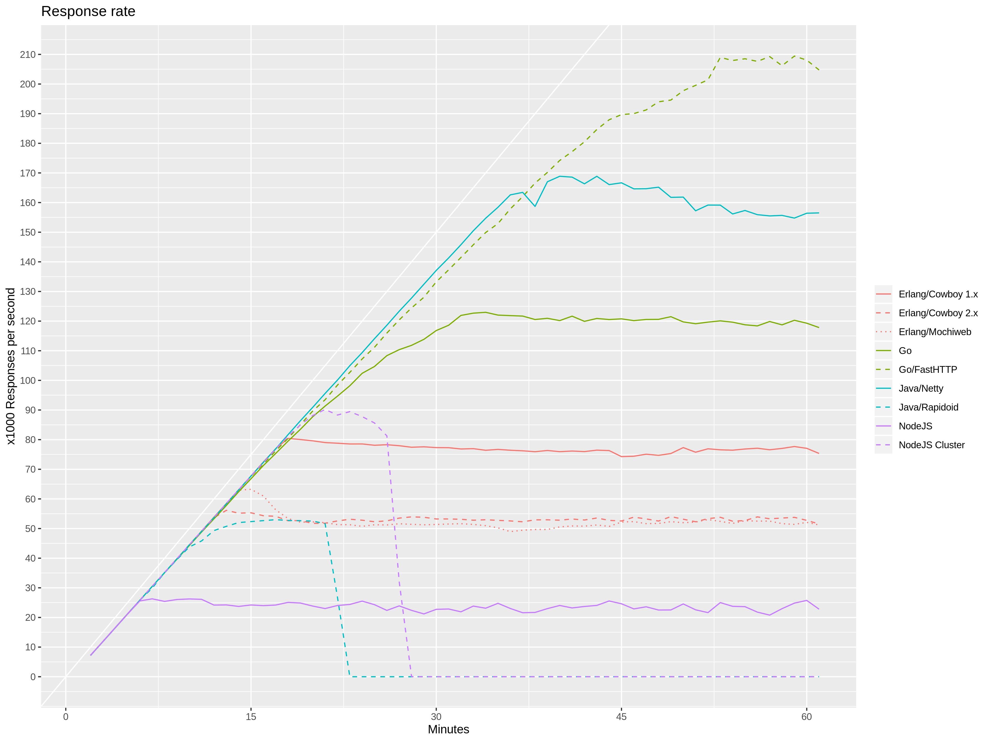
Response rate

Slide 8
https://stressgrid.com/blog/webserver_benchmark/

Slide 10
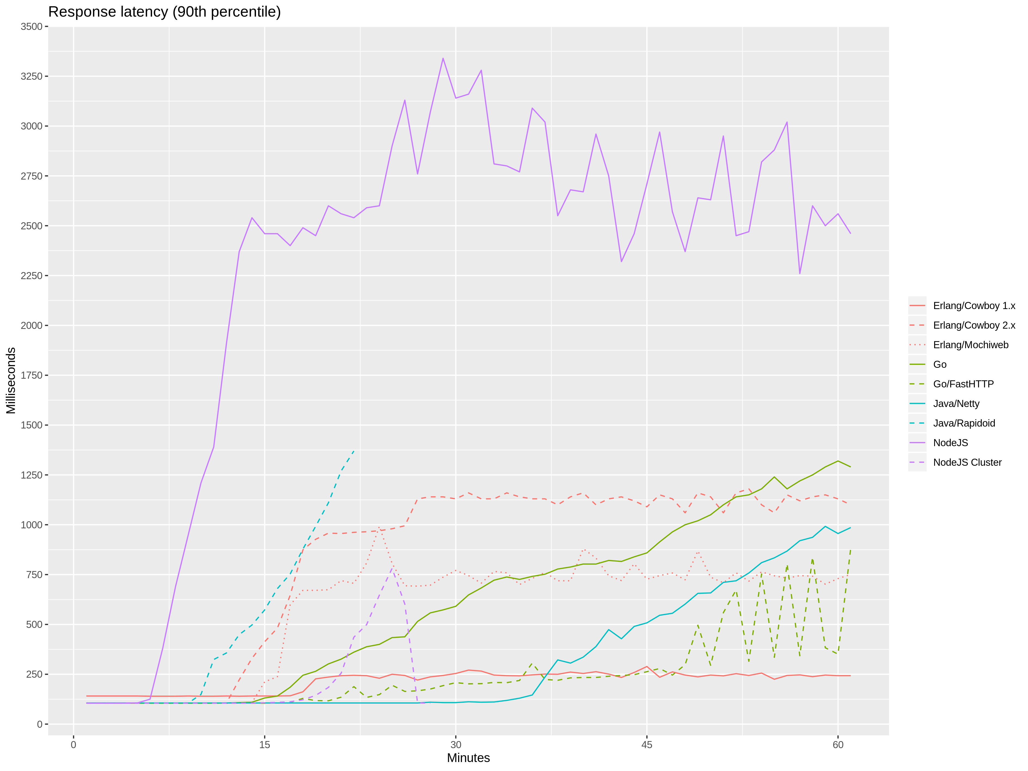
Response latency

Slide 12
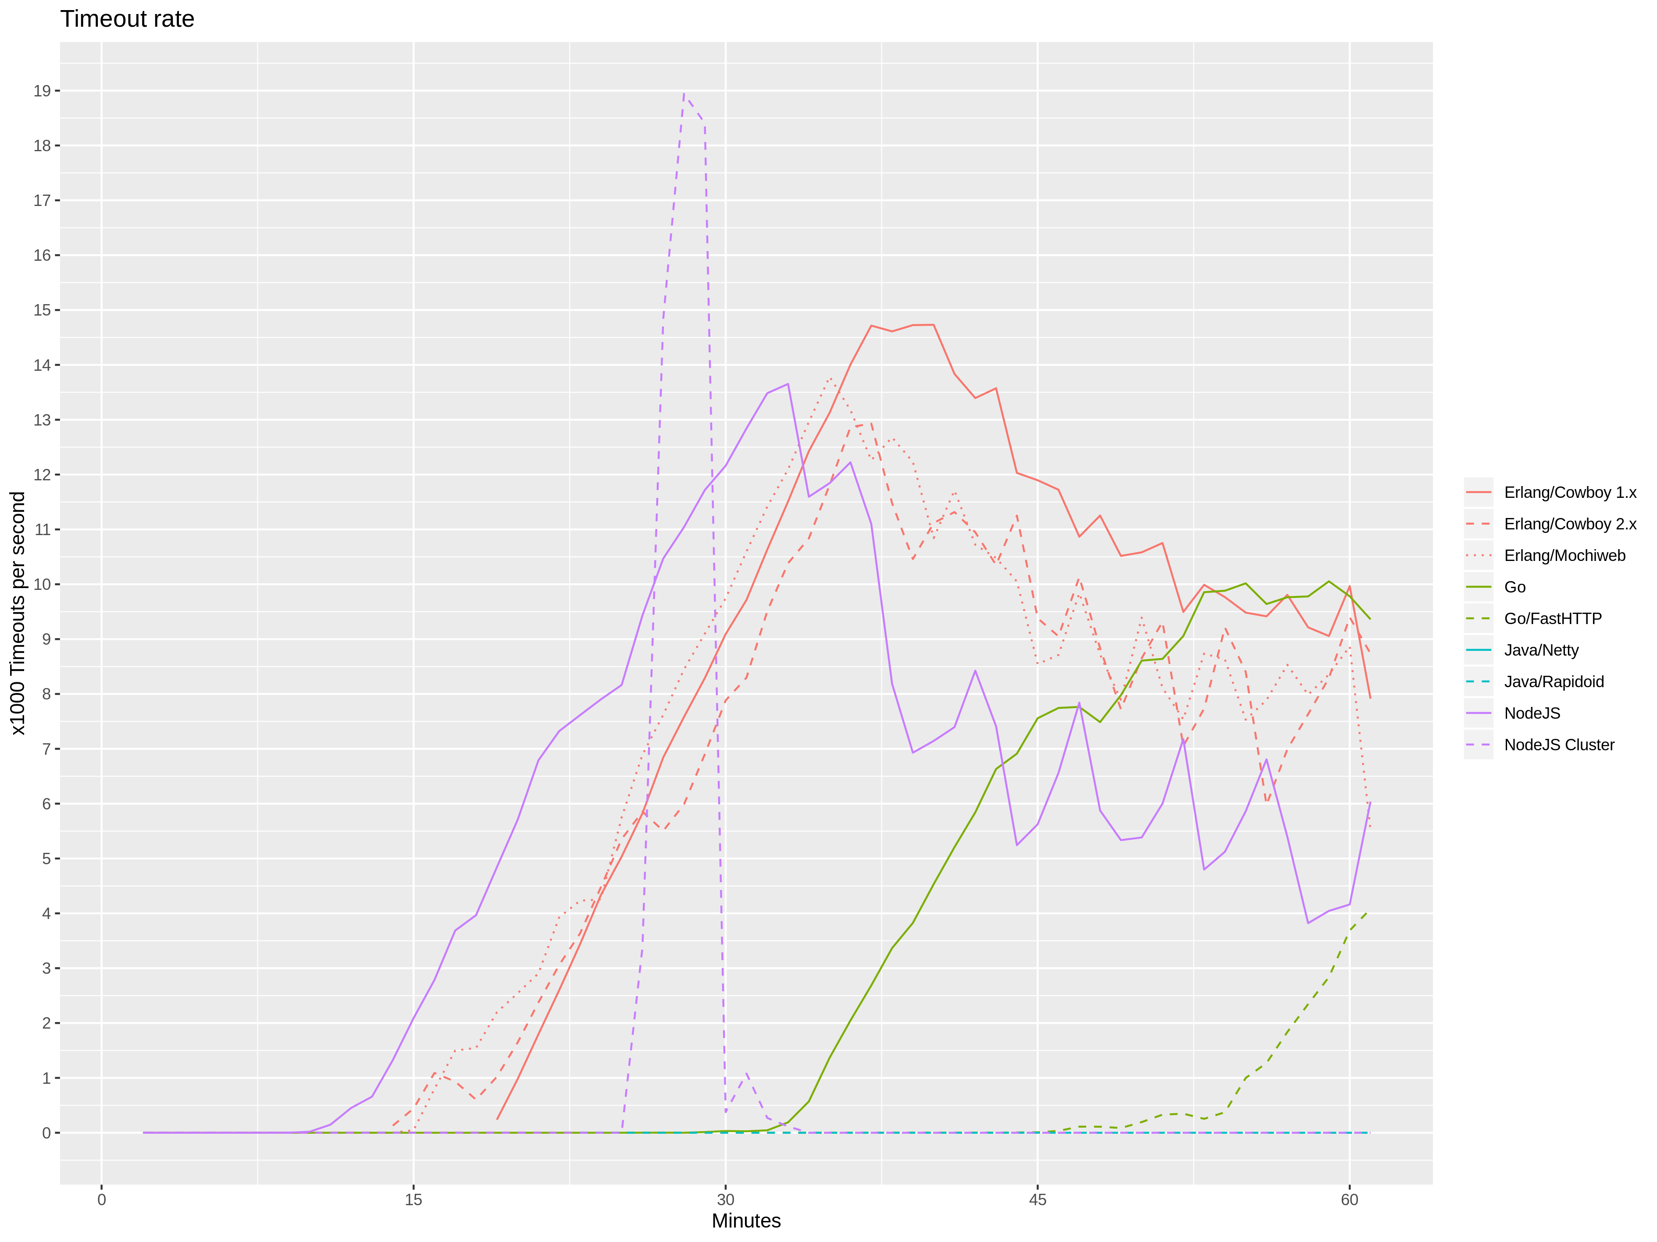
Timeout rate

Slide 13
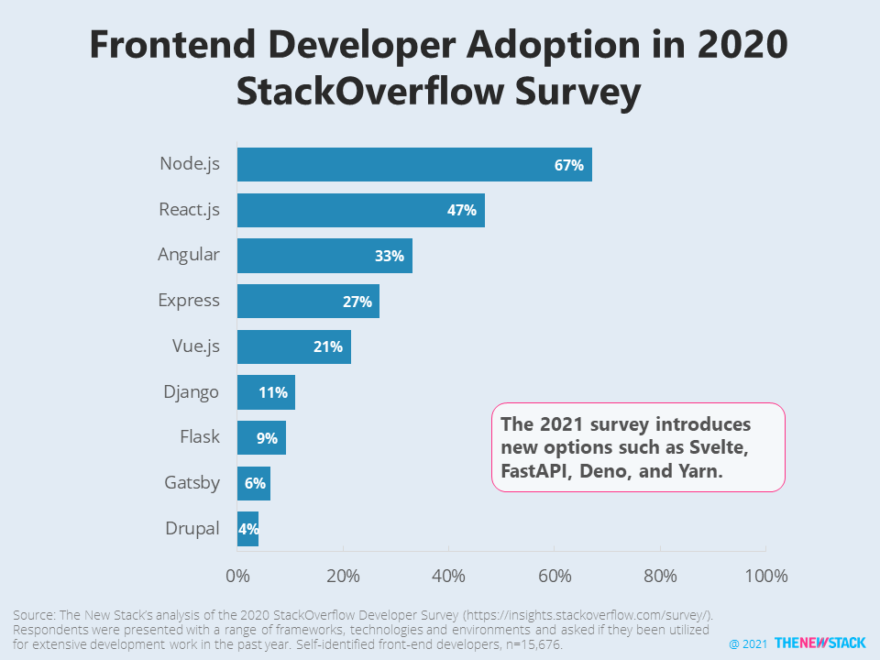
Frontend developers

